Slide 1

The Kamal N Jalan Memorial Lecture
Research in a UK District Hospital
Professor K D Bardhan
Rotherham District General Hospital, UK
Email: bardhan.sec@rothgen.nhs.uk
Friday 10th February 2017
Kolkata
Notes:
I am greatly honoured to be invited to deliver this inaugural lecture to honour a very distinguished Gastroenterologist in Kolkata whose insight and wonderful research has shaped medical practice far and wide. I had the honour of meeting the late Dr Kamal Jalan in 1991 at his centre when Dr Bose introduced us. I was inspired by the work he had done and the way its style is very similar to our own.
I am very grateful to Kalyan for the invitation. He is a very dear friend with whom I had the great privilege of working with in the 1980s and from whom I learned much and have been deeply inspired by the wonderful charitable work which he has done and continues to so do.
In delivering this talk I must make clear I am simply the “spokesman” for I speak on behalf of my amazing team and of the patients we have had the privilege to serve.
My only regret is that I cannot be there in person because of my wife’s illness so I am very grateful to my friend, Dr Matthew Kurien for helping with this presentation with its “voice over”.
There are 2 themes I would like to bring out
Firstly, that it has been an improbable journey !
Secondly, that many of the things we do in research and in modern clinical practice can be better shaped from past experience. We must beware that we don’t try and re-invent history but draw on experience from the past to help guide and shape the future.
I will later on explain how our group funded the research programme.
NEXT SLIDE

Slide 2
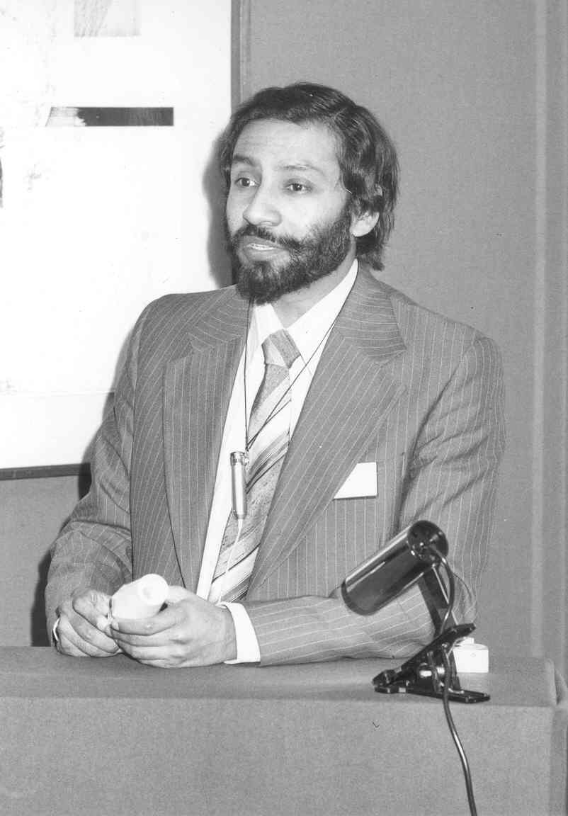
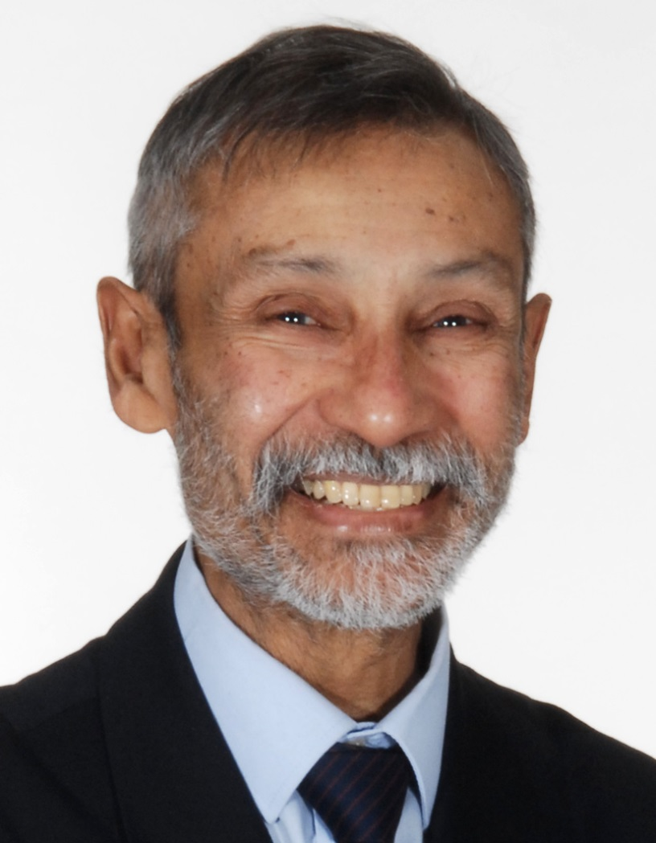
Prof K D Bardhan
1970s
Notes:
Who am I?
Just so you can put a face to the name, this is me in my younger days when I started in Rotherham, and me today.
Well actually the new photo was taken about the time of my 70th birthday – several years ago.
NEXT SLIDE

Slide 3
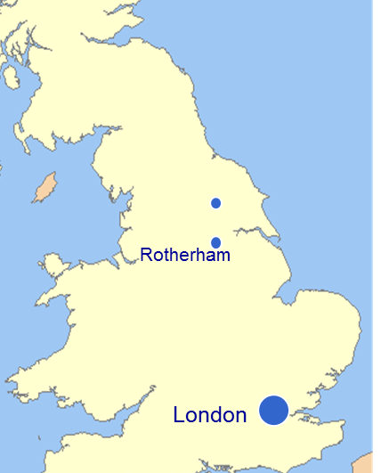
Where is Rotherham?
Rotherham
Industrial town
South Yorkshire
Population ~250 000
Notes:
Where is Rotherham?
So where is Rotherham situated you might ask - so let me give you some idea whereabouts in the UK our centre is based.
Rotherham is a town in the North of England, in the County of South Yorkshire
Population around 250 000
Industrial town based on coal and steel previously. Today more light industry and service industries such as call centres (those that aren’t in India)
NEXT SLIDE

Slide 4
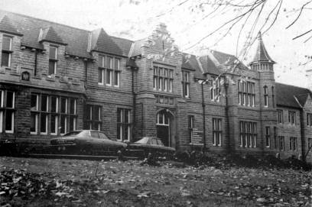
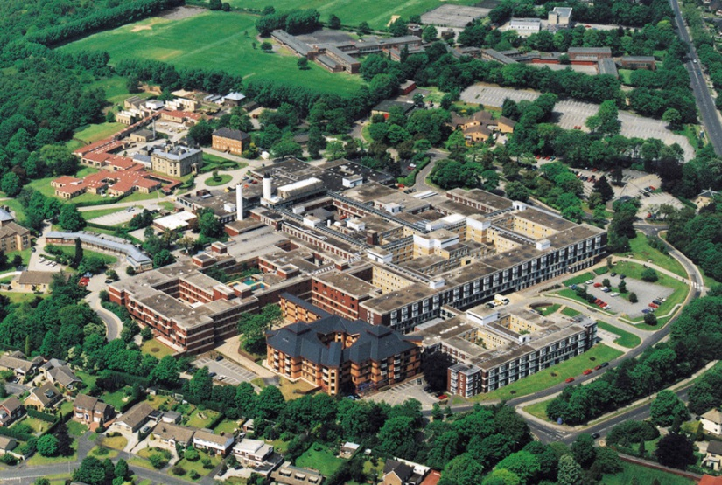
Rotherham District General Hospital
District General Hospital
Non-academic centre
New hospital opened 1978
Notes:
About the hospital
On the left here you can see a photo of the old hospital as it was when I started in 1973
To the right is the new hospital which opened in 1978.
This is a District General hospital – that is to say it is not an academic centre.
NEXT SLIDE

Slide 5
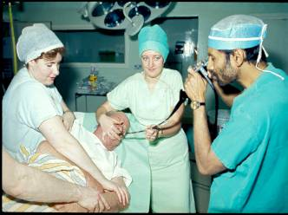
The growth of endoscopy in Rotherham
1972 Forward-viewing gastroscopes
1973 Consultant post in Rotherham
(with a £23 ‘research grant’)
1976 Experimental H2RA
November – cimetidine licensed
    high volume gastroscopy
    open access for GPs
Stupidity exceeded Sense!
– and still does!!
Notes:
I first used ‘forwarded viewing’ gastroscopes in my Registrar days in Sheffield.
In 1973 I was given the post of Consultant Gastroenterologist in Rotherham
I brought with me a small research grant of £23 – that’s worth 194 pounds today!
We developed an open access system where general practitioners could refer their patients directly for gastroscopy without having to be seen in the outpatient clinic beforehand. As H2RAs became available more patients were referred. Together these allowed high volume endoscopy to develop.
NEXT SLIDE

Slide 6
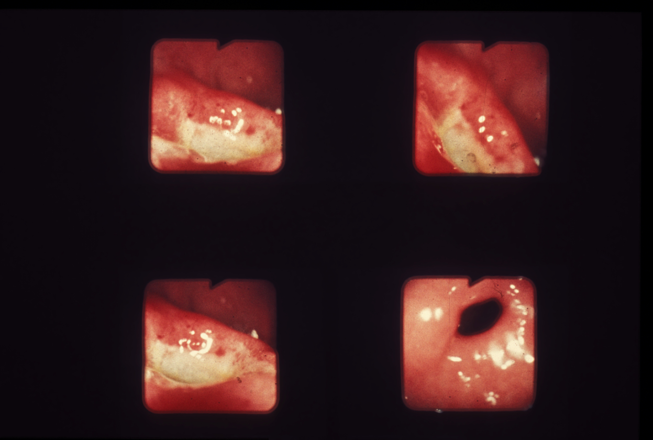
The first patient in the first UK cimetidine trial 1st April 1976
Notes:
Ladies and gentlemen, bear in mind that prior to this the only medical management for PUD in general and DU in particular was achieved by prolonged bed rest in hospital. You may well ask why the same could not be achieved by resting at home instead? It simply could not, as experience showed.
Within there is a deeper human story for these patients who were caught up in a vicious circle of peptic ulceration causing pain which made them unable to work causing financial hardship leading to stress and so on…....
This picture was taken on a very special day when the first patient to be given cimetidine in clinical trials in the UK was treated right here in Rotherham.
And bear in mind, the relatively short period after forward viewing gastroscopes became available.
It was exciting times with a lot was happening in a short space of time
NEXT SLIDE

Slide 7
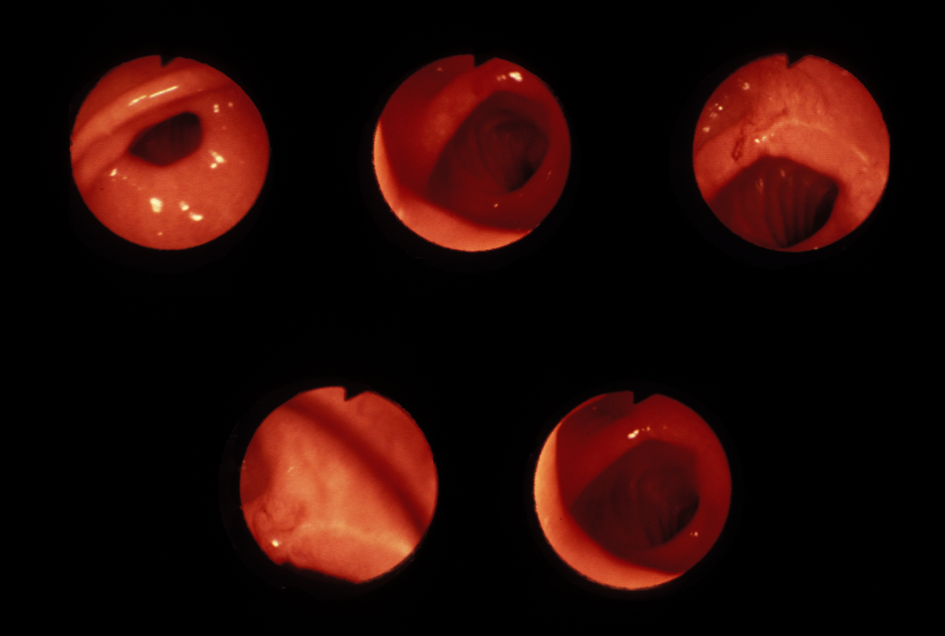
- - - and 4 weeks later !!
Notes:
……………………And 4 weeks later
And here we have photographs of the same patient just 4 weeks later ….. An absolute miracle for such rapid healing had rarely been witnessed before.
NEXT SLIDE

Slide 8
DU: The effect of cimetidine
Healed at 1 month on
Placebo CIM 1g daily CIM 2g daily
13/46 43/70 45/64
(28%) (61%) (70%)
Pain Relief
5
4
3
2
1
0
PL
CIM 1g
CIM 2g
Days
Nights
-1 1 2 3 4
-1 1 2 3 4
-1 1 2 3 4
Weeks
Rapid healing and pain relief
…The dawn of a new therapeutic era
Gut 1979; 20 : 68-74
Notes:
Rapid healing was achieved in around two-thirds of patients on cimetidine
More importantly for the individual patient was the rapid relief from pain which cimetidine gave. This had widespread benefit which in my earlier days I could never have imagined.
NEXT SLIDE

Slide 9
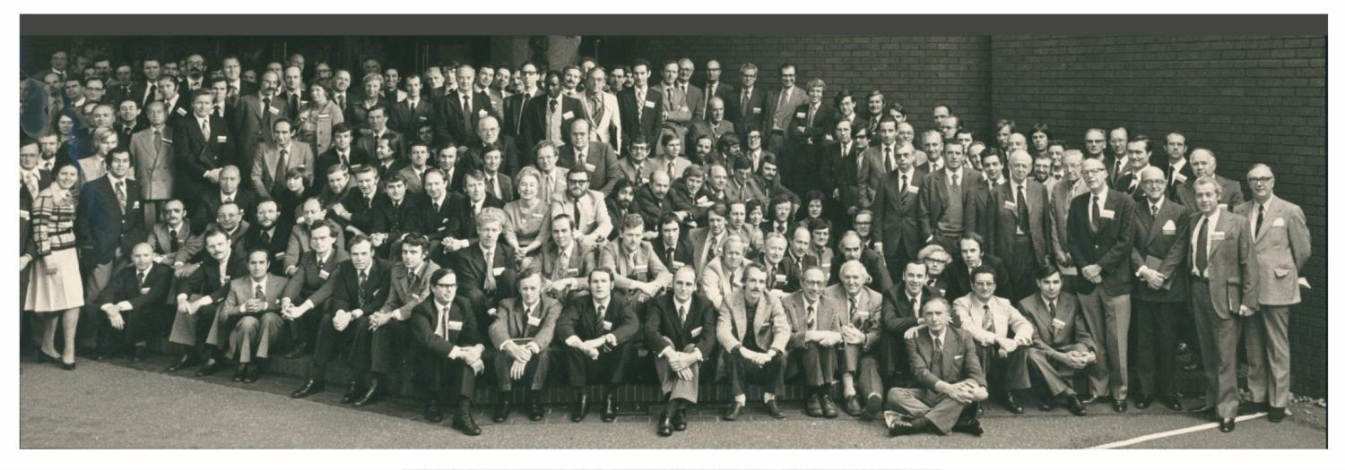
2nd International Conference on H2RA
Royal College of Physicians, London 26-27 Oct 1976
The “Great and the Good” ----- and one impostor!
Notes:
I had the honour to present results of the first cimetidine study in the international conference held at the Royal College of Physicians in 1976.
There were many distinguished investigators who were present including the great Morton Grossman flagged as number one and Sir Francis Avery Jones at number 2. --- and almost hidden in the middle is me!
NEXT SLIDE

Slide 10
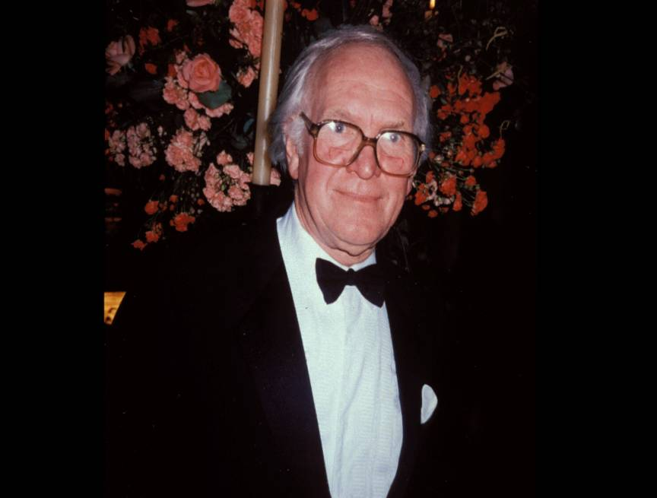
Prof Sir James Black Nobel Laureate 1988
Notes:
Here is Professor Sir James Black. It was he and his team who over a ten year period developed cimetidine. He was later awarded the Nobel prize for medicine.
NEXT SLIDE

Slide 11
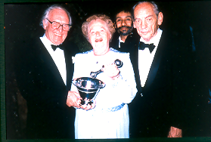
Prof Sir James Black --- and I
The pioneering days of “photobombing”?
Notes:
You can see not only was Rotherham pioneering in the use of cimetidine, it was also where “photobombing” began. Here are Sir James Black with his fellow Nobel laureates – and me!
NEXT SLIDE

Slide 12
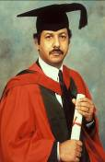
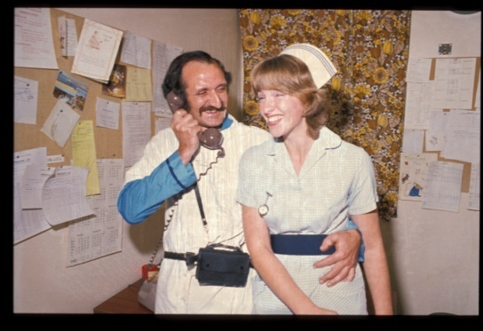
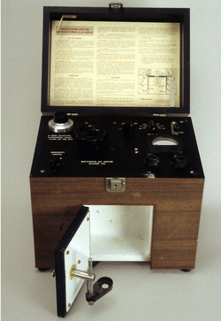
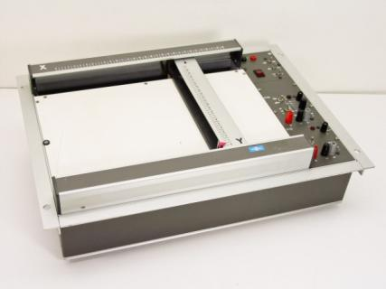
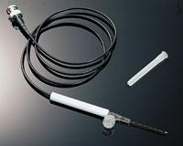
1975 : Opportunity!
Bhavnesh
(Bob) Kapur
-- Developed ambulatory 24h pH-metry – the subject of his PhD studies
-- His girlfriend (my clinic nurse!) -- had large family --- many volunteers!!
Notes:
The growth in endoscopy and PUD research in Rotherham presented the opportunity for our first PhD.
Bob Kapur developed a system of ambulatory pH metry.
It was helped by the fact that my clinic nurse was also Bob’s girlfriend. There were many volunteers amongst Trish’s large family.
Here you can see one of them fitted with the monitor and measuring equipment. This was state of the art at the time!
NEXT SLIDE

Slide 13
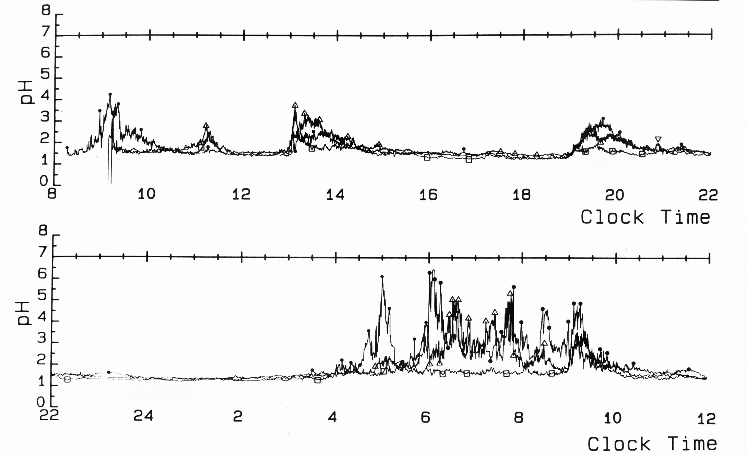
27 hour Ambulatory Gastric pH: Median
Healthy volunteers n=36
Healed DU n=55
The marvel of the “clock genes”
Nocturnal acid “switch off”: Fails when DU is active
Active DU n=30
Eur J Gastroenterol Hepatol 1990;2: 285-291
Notes:
Having observed the trace in the healthy, we were curious to know what happens in our duodenal ulcer patients. We found that when duodenal ulcer was active the acid switch off does not work in other words, when the duodenal ulcer is active the stomach does not seem to be aware of the time.
Of course today much more is known about circadian rhythm and Clock Genes which regulates daytime and night time acidity.
NEXT SLIDE

Slide 14
DU: Symptomatic relapse rate on low-dose H₂RA
Bardhan et al 1982
100
Bardhan et al, 1988
n = 180, placebo
75
%
Relapse
50
25
n = 321, Cim 400mg
0
0
1
2
3
4
5
6
7
8
9
10
Years
A single bedtime dose of cimetidine prevents ulcer recurrence in most
Notes:
Here you can see the longer term results of maintenance treatment for duodenal ulcer
Having healed the ulcer with cimetidine and the switching to placebo more than three-quarters relapse
within 2 years
In contrast just a single bed time dose of 400mg sustained prolonged remission for years in most.
NEXT SLIDE

Slide 15

The Rotherham Upper GI database
Gastroscopy: numbers per year
  1975 - 1500
  1992 – 6000 stable
UGI database: Key
  Prospectively collected data
  All patients followed up
  Mini summary in case notes
  Simple ‘Register’
  Card index
  1st computer 1987
  – all previous entries reviewed for accuracy
Notes:
So where do the longer term results come from?
From the outset we kept a register of endoscopy results.
As numbers escalated, reaching a peak in 1992, a ‘Card Index’ system was formed which had a card for each patient containing demographical details, endoscopy findings, treatment and outcome.
By 1987 personal computers were available and with the guidance of Bob Kapur we acquired a BBC computer. The enabled us to expand the amount of information we could collect.
At this time we had about 4000 patients in the database and over a period of several months we reviewed the notes of them all to extract additional data and ensure accuracy before entering them on to the computer. We also kept a handwritten card in the notes so at each visit a summary could quickly be seen - there was no sharing of computerised information in those days.
For the first time we were able to retrieve information quickly. The very first search we did was to see how many males and females were in the database. The search took just under 2 hours to find the answer – it seemed a miracle to us – how different it is today when we expect results in 2 seconds.
NEXT SLIDE

Slide 16
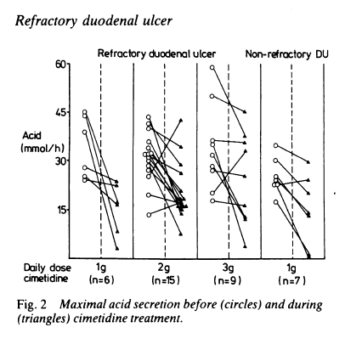
Early 1980s:
Cimetidine refractory duodenal ulcer?
 | Cimetidine 1g 57
Healed 8 |  | Not healed 49
 | Cimetidine 2g 58
Healed 8 | Not healed 15 | Default 1
Increased > 3g 8
Healed 4 |  | Not healed 4
Gut 1984;25:711-717
Notes:
So going back to the outcome of the patients
What happened to those whose ulcer did not heal quickly despite increasing the dose to 2 g or even 3g in some?
You can see on the right that:
the degree of acid reduction was variable between individuals
but the mean reduction was as great in the resistant ulcer patients as in the responsive
It did not appear to be dose related.
NEXT SLIDE

Slide 17
H2RA refractory duodenal ulcer 15 years on
Dig Liver Dis 2003;35(8):529-536
Notes:
Later we were able to examine failure to heal in over 750 patients and we were surprised by the timing of the refractoriness.
With each healing course of cimetidine or ranitidine, about 10% of patients proved to be refractory
Two thirds were refractory early on – on their first or second H2RA course but in one-third failure to heal came after several successful healing courses – as many as 8 in some.
NEXT SLIDE

Slide 18
Publications from the database: Peptic Ulcer
}
Giant gastric ulcer
                Dr G S Raju
Refractory gastric ulcer
Refractory duodenal ulcer
                Dr A K Nayyar
The outcome of bleeding duodenal ulcer
Admission rates for PUD in the Trent region 1972-2000
Time, change and PUD in Rotherham1977-2001
}
Notes:
We were able to publish a series of papers looking at long-term studies from the database.
Drs Raju and Nayyar were just 2 of our BRET Fellows who came to Rotherham from India.
Unfortunately time does not allow me to present all of our results to you today but I’ll just show you a sample
NEXT SLIDE

Slide 19
Newly diagnosed DU & GU 1977-2003
DU (n=5361)
GU (n=2091)
Digest Liver Dis 2006;38:163–168
Notes:
So peptic ulcer was our main interest in the early days
What we found over a 27 year period was a decline in the numbers of peptic ulcer,
as you can see from the trend lines, the decline was in duodenal ulcer.
There was a decline in gastric ulcer in younger people, but this was offset by increasing proportions of elderly.
Did this result in less work for the gastroenterologists?
NEXT SLIDE

Slide 20
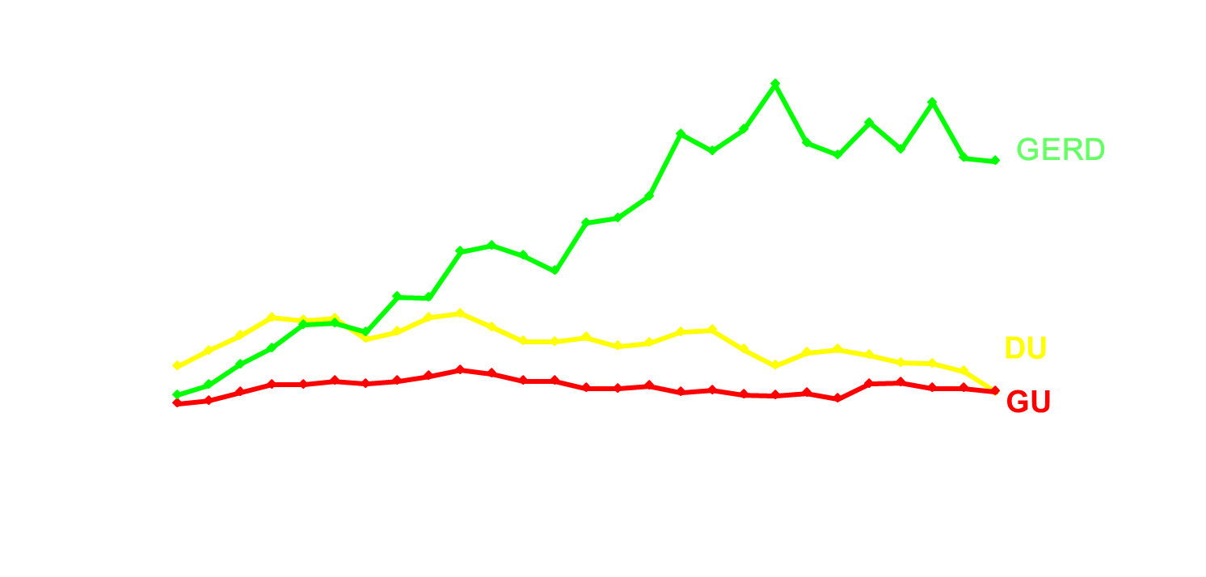
Reflux Rising
Gastro-oesophageal reflux disease
(n=13,786)
Digest Liver Dis 2006;38:163–168
Notes:
One might say God was on the side of the gastroenterologist
As peptic ulcer was declining there was a rapid increase in the numbers of patients presenting with gastroesophageal reflux disease.
When we presented our data on the rising tide of reflux disease it was met with the view that this was well known. However, this was anecdotal - we could not find anything in the literature and to the best of our knowledge our description of reflux rising was the first of its kind.
This opened up new avenues of investigation for us
NEXT SLIDE

Slide 21
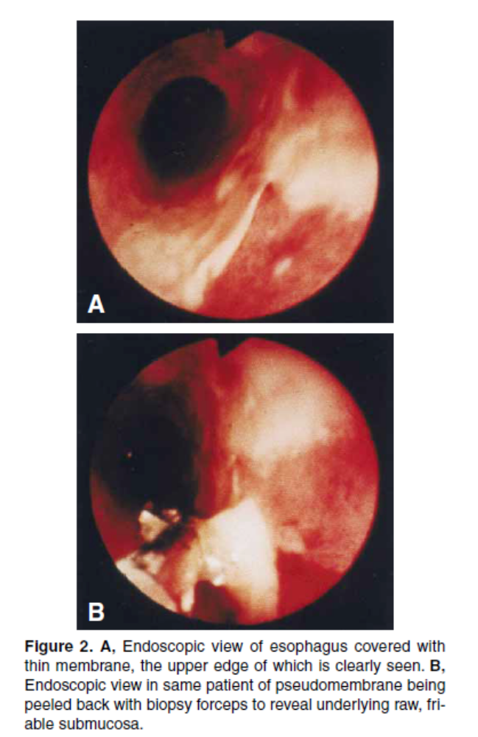
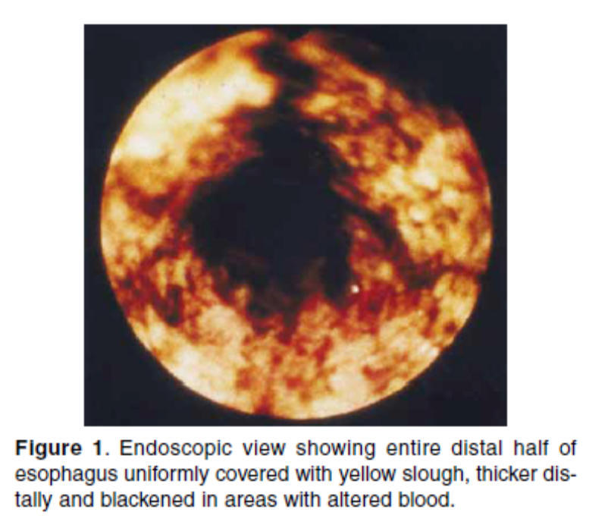
Pseudomembranous oesophagitis
A Nayyar et al
Gastrointestinal Endoscopy 2001;54(6):730-735
Notes:
From our large reflux population we investigated several areas most latterly Barrett’s esophagus. I will return to the Barrett’s work later but would like to show you some photographs of one interesting element from the reflux population
This poster created much interest at the British Society meeting in Brighton where we were able to draw attention to an unusual oesophageal condition about which little was known. You may have seen images like this at endoscopy at your centre. Several had, but no-one seemed to know what it was.
We used the term ‘pseudomembranous esophagitis’ for this distinctive appearance. A thin membrane covers the lower half and occasionally the whole of the oesophagus. Often yellow or blackened in areas, it can be peeled away with biopsy forceps. Its appearance is very different to the usual erosive changes seen in reflux disease.
In fact it was related to systemic illness, usually in the elderly rather than to reflux. It heals very rapidly whether treated with acid suppression or not once the patient begins to recover.
NEXT SLIDE

Slide 22

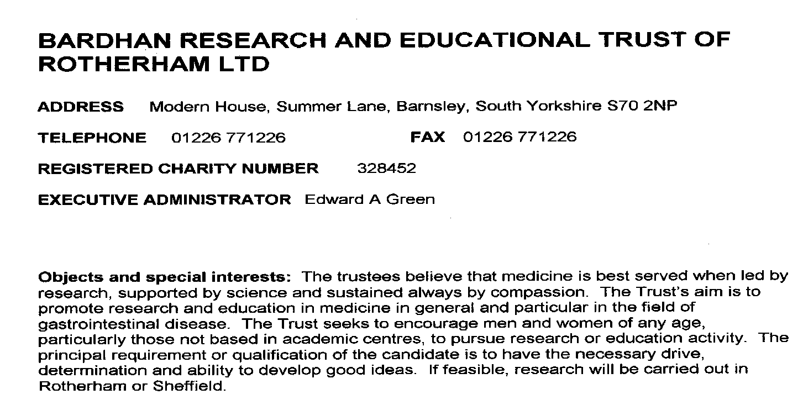
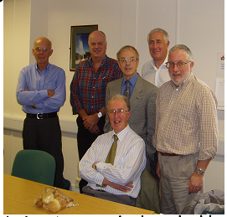
The creation of BRET – the turning point!
Prof. Chris Potter, Dr. Martin Clark, Dr. Derek Holdsworth, Mr. David Hinchliffe (Chairman), Mr. Robbie Cockburn,
Eddy Green (Exec. Administrator)
Notes:
Most of our research was funded using income generated by collaboration with the pharmaceutical industry, particularly in early development stages, which was always a joy for we were working with first class scientists and medical teams.
These funds were held at the hospital. However, later on new regulations were introduced which made it necessary to make separate arrangements to protect the funds. This became the spur to the creation of our research charity in 1989.
As I was to learn, registering a charity is a complex matter. Since the spirit of our charity is research, education & training, we called it exactly that, The Research & Education Trust. However, the Charity Commissioners insisted there needed to be a more specific name, so on the spur of the moment when phoned by the lawyer in the middle of a busy endoscopy list, it became The Bardhan Research & Education Trust.
NEXT SLIDE

Slide 23
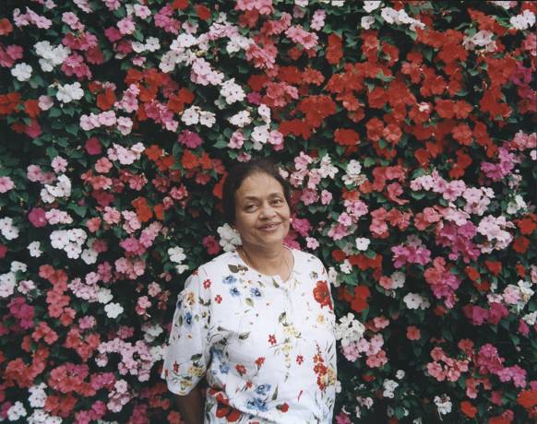
The Bardhan Research and Education Trust
Registered Charity no. 328452
Dr Gouri Bardhan --- my wife!
Notes:
Most of our research was funded using income generated by collaboration with the pharmaceutical industry, particularly in early development stages, which was always a joy for we were working with first class scientists and medical teams.
These funds were held at the hospital. However, later on new regulations were introduced which made it necessary to make separate arrangements to protect the funds. This became the spur to the creation of our research charity in 1989.
As I was to learn, registering a charity is a complex matter. Since the spirit of our charity is research, education & training, we called it exactly that, The Research & Education Trust. However, the Charity Commissioners insisted there needed to be a more specific name, so on the spur of the moment when phoned by the lawyer in the middle of a busy endoscopy list, it became The Bardhan Research & Education Trust.
NEXT SLIDE

Slide 24
BRET
Clinical
Epidemiology,
Natural history, Treatment
Rotherham Hospital, University of Sheffield & other University centres
Applied Science
Translational
Fundamental Science
For its own sake!
From Bed to Bench and back to Bed!
Notes:
As a clinician, much of our team’s work was clinically driven. We made several observations which intrigued us and led to exploration through fundamental science studies, that is to say curiosity-driven for its own sake. These studies were carried out both at Rotherham Hospital and the nearby University of Sheffield, and later on in collaboration with other university centres.
Several of the results that emerged could then be incorporated back into clinical medicine, a wonderful example for us on the nature of translational research.
So if I was to use just a one sentence description of the BRET model, it would be from the bedside to the bench and then from bench back to bedside. NEXT SLIDE

Slide 25
BRET: Registered Charity no. 328452
Objects and special interests: The Trustees believe that medicine is best served when led by research, supported by science and sustained always by compassion. The Trust’s aim is to promote research and education in medicine and particularly in the field of gastrointestinal disease. The Trust seeks to encourage men and women of any age, particularly those not based in academic centres, to pursue research or education activity. The principal requirement or qualification of the candidate is to have the necessary drive, determination and ability to develop good ideas. If feasible, research will be carried out in Rotherham or Sheffield.
(This was later expanded and BRET became a national charity)
Notes:
The principal requirement or qualification of the candidate is to have the necessary drive, determination and ability to develop good ideas. The person’s background or educational status is not nearly as important as their character.
The aim was for research to be carried out in Rotherham or Sheffield but in fact BRET became a national charity and also helped candidates from overseas.
NEXT SLIDE

Slide 26
BRET: Registered Charity no. 328452
Objects and special interests: The Trustees believe that medicine is best served when led by research, supported by science and sustained always by compassion. The Trust’s aim is to promote research and education in medicine and particularly in the field of gastrointestinal disease. The Trust seeks to encourage men and women of any age, particularly those not based in academic centres, to pursue research or education activity. The principal requirement or qualification of the candidate is to have the necessary drive, determination and ability to develop good ideas. If feasible, research will be carried out in Rotherham or Sheffield.
(This was later expanded and BRET became a national charity)
Notes:
A further aim of the Trust was to encourage researchers of any age.
A wonderful example of age not being a barrier is the work of the remarkable surgeon Mr Frank Tovey.
NEXT SLIDE

Slide 27
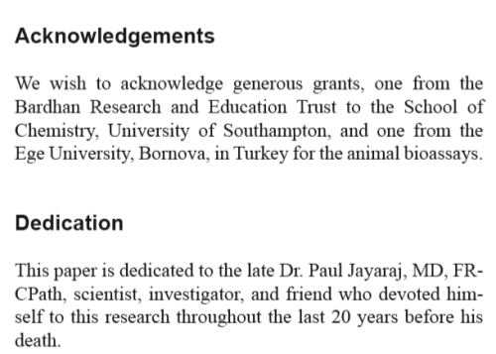
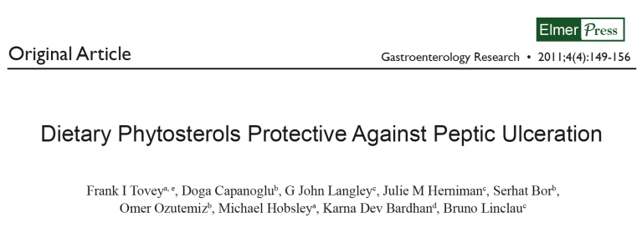
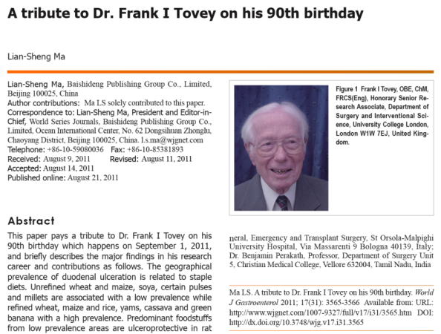
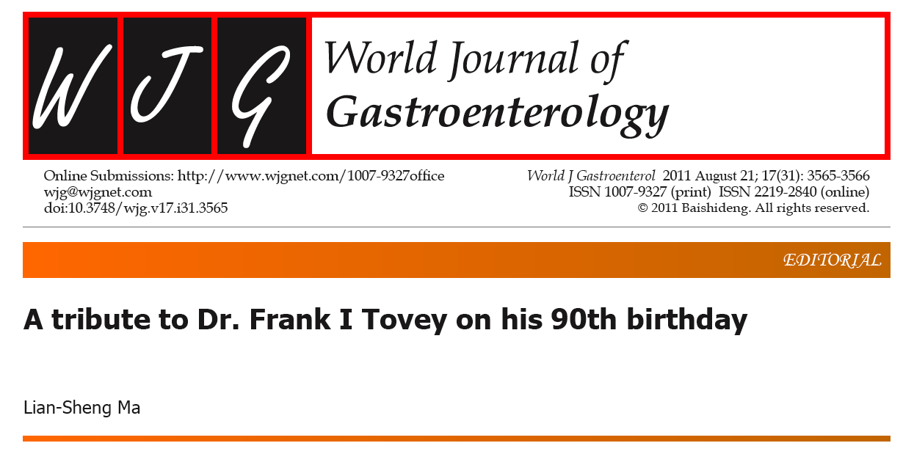
Frank Tovey OBE ---a life’s work
1955 J. Indian Med Assoc. 1955 Dec 16;25(14):548-51. Relation of hookworm infestation with duodenal ulcer. Leslie H, Tovey FI.
2011
Age 90!
2015 World J Gastroenterol. 2015;21(5):1377-84. Role of dietary phospholipids and phytosterols in protection against peptic ulceration as shown by experiments on rats. Tovey FI.
Notes:
Frank worked as a surgeon for two years in a mission hospital in SW China where his work came to an end with the turbulent political situation.
In 1951 Frank and his late wife Winnie were posted to Mysore where they stayed for 16 years.
Amongst his work was the development of reconstructive surgery in leprosy, while Winnie helped with his research and the setting up of rural leprosy clinics.
He also developed a major interest in the geographical distribution of duodenal ulcer in India and its relationship to staple diets.
Upon his return to the UK in 1968 he continued research into dietary factors which protect against duodenal ulcer.
He has written widely on peptic ulcer disease in India and dietary factors relating to ulcer disease. His 1st paper on PUD was in 1955, and the latest in 2015 – a remarkable span of 60 years.
Just to show that BRET does encourage researchers of any age, BRET was able to support some of Frank’s research as shown by his paper of 2011, written at the age of 90 (although he was only in his late 80s when the grant was made)
NEXT SLIDE

Slide 28




The nature of
BRET research – Mentorship
A Real Mentor …Nurture, Guide, Friend
Nurture …
The person
and the project
Notes:
The central feature of BRET supported research is first class mentorship. The mentor must be able to devote time to nurture and guide the person. In effect, the project is the means to grow the person so that she/he can then become an independent researcher.
NEXT SLIDE

Slide 29
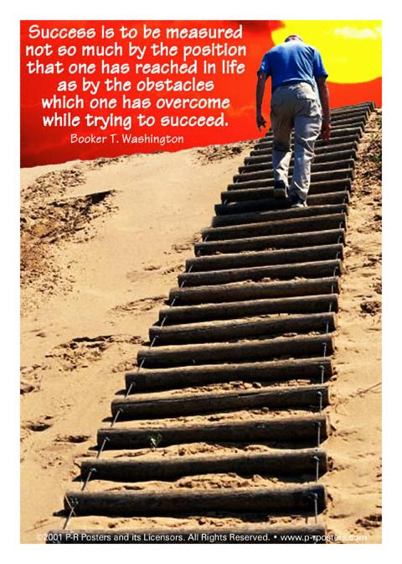
The Nature of BRET Research ----
Measuring success---
GSR Mk3
29
Notes:
And finally, how is success to be measured? I can only quote Booker T Washington, who was descended from slaves. He writes, “Success is to be measured not so much by the position that one has reached in life as by the obstacles which one has overcome while trying to succeed.”
NEXT SLIDE

Slide 30
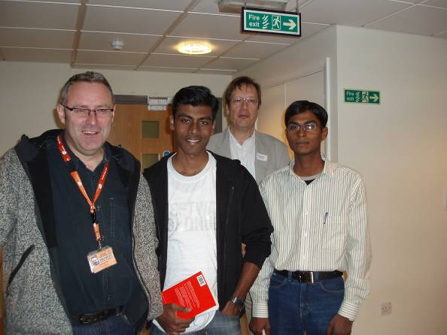
BRET: People supported …
Higher Degrees
19 PhDs
4 Post-Doctorals (medicine and science)
5 MDs
Other R & D grants
Education: MSc. Mol. Sci
Medical School Fellowships
(for talented students from India who
could not otherwise afford the training).
Rotherham
KDB Research team
(Database, Secretary)
BRET India Fellows at University of Sheffield Medical School
Dr Jon Shaw & Dr Martin Nicklin with Master’s Students from Chennai & Sholapur
Notes:
So who has BRET supported?
In addition to a large number of higher degrees both medical and science, it has also supported education. Specifically, it made grants available to talented students from all over India who wanted training in the molecular science Masters course but who did not have the means to support this.
Two sets of 3 students each were supported. I am please to say all 6 of them are currently doing PhDs or post-doctoral Fellowships at various places in Europe.
Crucially BRET has supported our own internal team members specifically Christine Royston who developed our extraordinary database and Beverley Mason who has co-ordinated all our education and research programmes. I should add that Christine joined me in 1985 and Bev in 1981 – and they are still with me today, a measure of their patience and fortitude! – they have lived in the hope that some day I will be able to crack a decent joke at which point they can retire!!

Slide 31
Main Themes
Clinical areas
Fundamental - Translational
Peptic Ulcer Disease
GORD
H. pylori
Bile acid malabsorption
Fermentome
Gut blood flow
Adhesions
Extra oesophageal reflux
Irritable bowel syndrome
Inflammatory bowel disease
Liver
Microcirculation (PUD)
Macrocirculation (SMA)
Impedance: Acid detection*
Impedance: Barrett’s dysplasia
MR detection of adhesions
E-nose for VOC detection
Pepsin in extra oesophageal reflux
Mechanisms of liver damage (CLEVER 1)
*Impedance: Non-invasive
  Measuring stomach acid
  Detecting GORD
Notes:
Our work has led us into numerous areas of investigation but time is too constrained to presents results from all.
Some of our BRET Fellows are with you today. Matt Kurien and Neena Kalia have presented some of their work to you already this morning. Later David Randall will present his work on the detection of adhesions and Shishir Shetty on liver fibrosis.
I will concentrate on just a few areas which had a major effect on our thinking and which may be of particular interest to you.
NEXT SLIDE

Slide 32
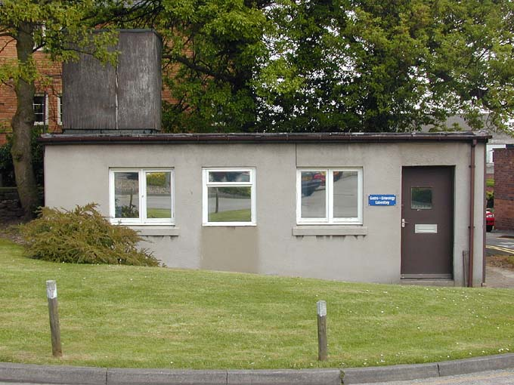
My lab! --- little, but happy!!!
Notes:
And here it is
A small, compact but fully functioning laboratory from which much has emerged.
Let me give you an example.
NEXT SLIDE.

Slide 33
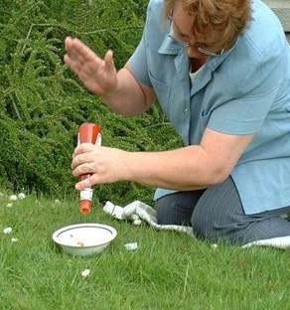
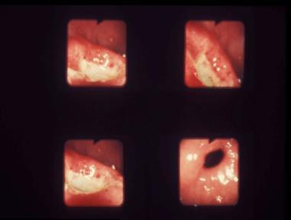
Why thump ketchup >>> Blood flow …..
Ketchup / Blood
Non-Newtonian fluid
>>> movement keeps it fluid
>>> fibrinolysis needed to keep blood moving
Question
If fibrinolysis is reduced
Blood thicker / clots?
Mucosal necrosis i.e. ulcer?
?
Hypothesis
Mucosal fibrinolysis is reduced in DU
Notes:
Being the eccentric I am I could not help wonder if the tomato ketchup scenario might explain how duodenal ulcers form, let me explain my way of thinking
Blood I was told is also a non-Newtonian fluid so needs to be kept moving
We know that in health there is a wonderful system of fibrinolysis which ensures that clots do not form
I could not help but wonder if fibrinolysis was in any way impaired in duodenal ulcer disease. This became the hypothesis for a series of studies.
NEXT SLIDE

Slide 34
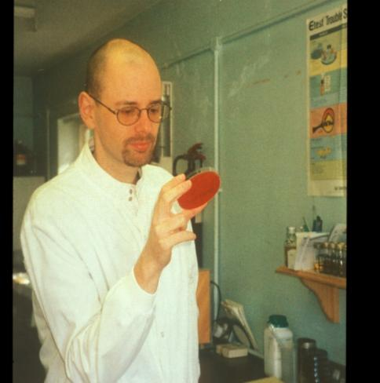
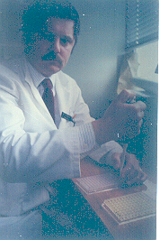
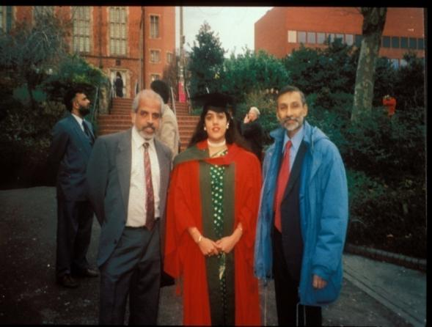
PUD: Problems of Microcirculation?
1991- 92 : Mark Wodzinski
Impaired fibrinolysis at ulcer edge
Gut 1993; 34: 1310-4
1993 – 2000
Darren Morton
H. pylori
1994 - 97:Neena Kalia
Diet & PUD
- H. pylori & microcirculation
Notes:
By sheer good fortune Mark Wodzinski, a trainee in haematology spent a couple of years with us.
Sure enough, Mark confirmed that fibrinolysis is indeed reduced at the ulcer edges
Two other people later joined us
The first is Neena Khalia who you met earlier. Neena was a physiology student working with my Vellore classmate Sam Jacob. Sam was very impressed by Neena and so introduced us. Neena of course is now a world class microcirculation expert but I want to take you back to her formative days.
As Neena’s work expanded Darren Morton a microbiology scientist also joined the BRET team to further explore the role of Helicobacter pylori in the formation of peptic ulcer.
This was a rare conjunction of talent.
So let me tell you something about the early days.
NEXT SLIDE

Slide 35
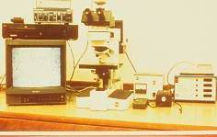
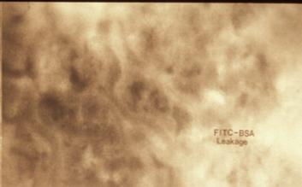
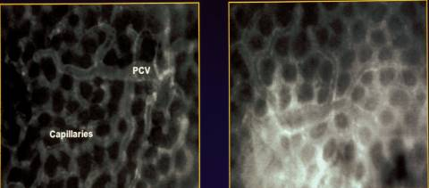
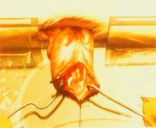
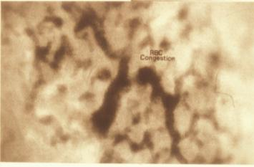
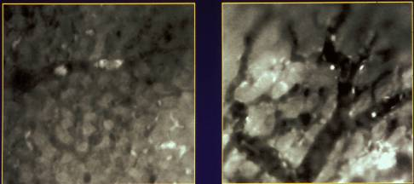
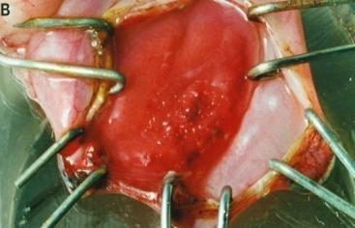
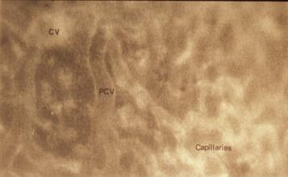
The effect of alcohol on the mucosal microcirculation
Baseline
Soaked in alcohol
Labelled albumin
Equipment
Leakage
Contained
Leaking
Rat stomach
Congestion & stasis
Platelet emboli & thrombi
Leukocyte adhesion
Normal
Focal necrosis
Gut 1997; 41 : 748-752
Notes:
This is the work Neena carried out in her early days.
Starting with the 1st column on the left. At the top you can see the equipment Neena used to study microcirculation. The rat is 1st anaesthetised and its stomach then brought out of its abdomen which allows one to look at the microcirculation within.
You can see the normal stomach at the bottom of this 1st column. Importantly, there is no leakage.
BUT if you then soak the stomach in alcohol you can observe stunning changes as the 2nd column shows.
It begins with leakage
Ends with congestion and statis
BUT far from the whole mucosa being damaged as expected, crucially, there are just a few tiny areas of focal necrosis
This is the equivalent of using a blow torch on the wall but instead of the whole area being damaged, it is restricted to just a few tiny areas. Clearly, there must be some way whereby the effects of such damage is somehow diffused out thereby most of the mucosa remains protected.
One can also begin to understand that an area damaged like this by alcohol could be similarly damaged by stomach acid. In other words it is a form of peptic ulcer but a very crude one. We were beginning to understand how ulcers might form.
It is here that Neena’s genius came in. Looking now at the 4 Figures on the right. Using labelled albumin she could now show that the microcirculation damage starts with leaking of albumin followed by platelet emboli and thrombi. The next step is that the leukocytes which should be flowing steadily through the circulation now get stuck within the vessels.
NEXT SLIDE

Slide 36
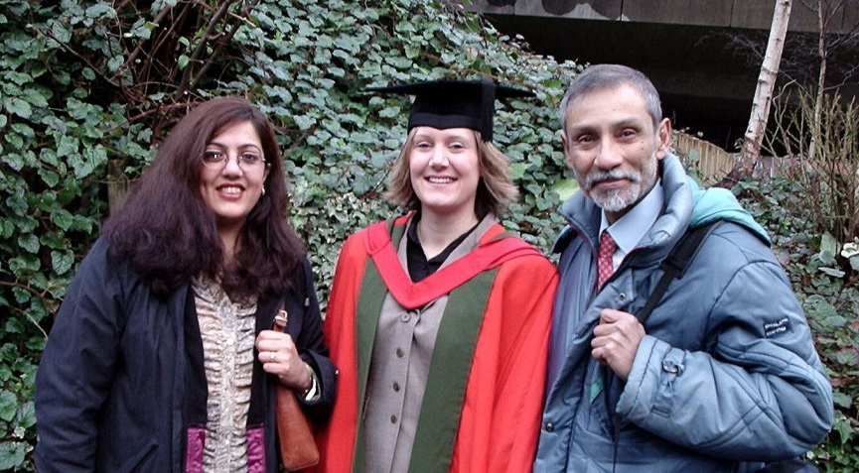
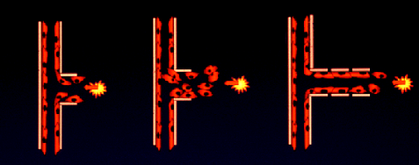
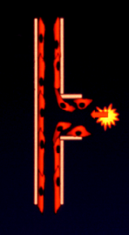
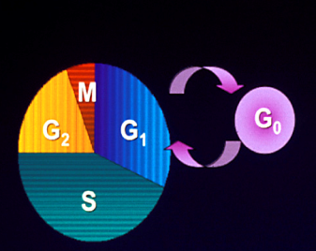
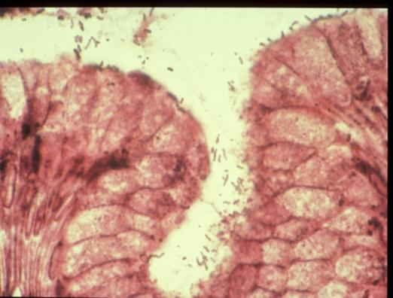
Effect of helicobacter pylori angiogenesis?
Stages of Angiogenesis
Hannah Pearce
1999 - 2002
H. pylori blocks the cell cycle
J Gastroenterol & Hepatol 2003;18(10):1180-7 Digestion 2004:69(4):201-10
Notes:
Neena completed her own PhD and then as a post-Doctoral Fellow supervised Hannah Pearce in examining the effect of h. pylori on new blood vessel formation. Again, some remarkable findings emerged.
In the absence of helicobacter new vessels develop as solid buds which then get hollowed out to form new vessels as shown in the model of angiogenesis on top right the slide.
Using extracts of helicobacter cultured by Darren, Hannah examined its effects on the microcirculation.
The striking feature was it that it blocked the cell cycle thereby preventing new buds from forming. This block occurs at the very first stage of the cell cycle, the G zero, in other words new vessels do not develop.
We were aware there is an extensive network of blood vessels and collaterals throughout the stomach and duodenum which protect the mucosa so would expect the adverse effects of hp on angiogenesis would be widespread.
In fact, most peptic ulcers are limited to the lesser curve of the stomach or 1st part of duodenum and we could not understand the reason for this. The answer came quite by chance
NEXT SLIDE

Slide 37
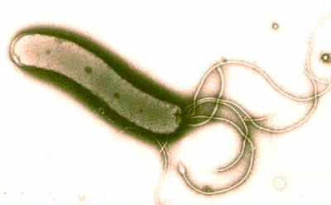

The development of peptic ulcer: A model
H.pylori infection
Microcirculation damage
End vessel damage + Reduced fibrinolysis
Mucosal infarction: ulcer
Hp persists: angiogenesis inhibited
Kalia et al, series of papers 2001-2004
Ulcer perpetuated
Notes:
At this stage whilst I was the Secretary of our regional gastroenterology society I had a call form an anatomist and microcirculation expert who wanted to present some of his work at one of our meetings.
We got chatting. I told him of my lack of understanding in this area whereupon he drew attention to his own work which clearly demonstrated that the ulcer bearing area is the only part of the UGI tract where there are no collaterals, only end vessels. In other words, if end vessels got blocked, that zone of mucosa cannot be rescued by collaterals. This now provided a compelling answer to the mystery why H pylori peptic ulcers are restricted to a small area.
We also know from other evidence that in the presence of hp infection acid secretion is actually increased
NEXT SLIDE

Slide 38


Mini-dose H. pylori: ¹⁴C Urea Breath Test (UBT)
Culture positive
¹³C-UBT
European
Standard Test
Culture negative
¹⁴C-UBT Mini-dose test
¹⁴C UBT
Supported all our Hp R & D & clinical practice
On-site, real-time, less expensive
Our standard test for many years
Raju et al Am JGE 1994; 89: 1027-31
Notes:
This graph shows the correlation between the two breath tests carried out on the same patients. On the vertical axis you can see the results of the 13C UBT, which is the European standard test. On the horizontal axis you can see our mini-dose 14C UBT. In many centres the gold standard for the presence of H.pylori has been histology. We on the other hand had excellent microbiology and yes we do use histology but we prefer to use microbiology because the results are more reliable. Therefore, on head to head testing you can see that our simple test was just as reliable as the gold standard in distinguishing those who had negative Hp cultures vs those who had positive cultures.
This way of making the most of what is available was a characteristic of our unit.
NEXT SLIDE

Slide 39

Bile acid circulation
Normal:
~95%-98% absorbed in terminal ileum
Re-circulated up to x7 in 24 hours
Bile Acid Malabsorption
TI absorption reduced
Excess unabsorbed BA spills into colon
Interferes with calcium-mediated water & electrolyte absorption
Notes:
The underlying principle is illustrated here.
Bile acids are produced in the liver and concentrated in the gall bladder, which then ejects its contents into the duodenum just as food starts to arrive. Almost 97% of the bile acids are then reabsorbed in the terminal ileum and recycled, and only a small amount, some 3%, is passed into the colon where it reduces water reabsorption thereby keeping the stools soft.
So how do we measure the absorption rate?
NEXT SLIDE

Slide 40






The SeHCAT retention test: Rotherham 2000s
SeHCAT
Uncollimated gamma camera
5 minute AP, PA views and background
BAM = retention at day-7 < 10%
Notes:
SeHCAT is a synthetic bile acid labelled with selenium. It is not metabolised nor is it broken down by bacteria. But being a bile acid, it tracks the enterohepatic circulation.
A capsule with ⁷⁵SeHCAT is swallowed with water to ensure that it reaches the stomach
The equipment is a standard gamma camera, which I assure you will be available in many centres in India
Baseline readings are taken supine and prone, and these measurements are then repeated after 7 days.
From these measurements, the percentage of SeHCAT retained at Day-7 can be calculated.
We use a cut-off of 10%. Any retention less than 10% signifies bile acid malabsorption.
NEXT SLIDE

Slide 41
Bile acid malabsorption (1989 – 1998)
Chronic diarrhea in:
Number
BAM
Ileal resection
37
36 (97%)
Ileal Crohn’s; unoperated
44
24 (54%)
Cholecystectomy ± gastric surgery
26
15 (58%)
J R Coll Physicians Lond 2000; 34: 448-51
Notes:
These are our results in the first 10 years of our experience.
All of these patients had chronic diarrhoea, which is the reason for doing the SeHCAT test.
Of those with ileal resection, almost all had BAM (97%). Of those who had ileal Crohn’s which had not been operated upon and others who had cholecystectomy with or without additional gastric surgery, more than half had BAM
NEXT SLIDE

Slide 42
Bile acid malabsorption (1989 – 1998)
Chronic diarrhea in:
Number
BAM
Ileal resection
37
36 (97%)
Ileal Crohn’s; unoperated
44
24 (54%)
Cholecystectomy ± gastric surgery
26
15 (58%)
Diarrhoea-predominant
irritable bowel syndrome
197
65 (33%)
J R Coll Physicians Lond 2000; 34: 448-51
Notes:
The biggest surprise of all were patients whom I had labelled as diarrhoea-predominant irritable bowel syndrome, as was the custom at the time. One-third had BAM. The point I want to stress is that although in percentage terms of malabsorption it is only one-third, the patient group per se was by far the largest, almost 200 patients
So do these patients with primary bile acid diarrhoea respond to treatment?
NEXT SLIDE
NEXT SLIDE

Slide 43


Distal UC; proximal constipation
Female, age 64
Retained markers
“Mush”
Right
Left
Right side magnified
“Mush” in caecum & ascending colon contents
Notes:
In 2002, I suffered a cardiac arrest whilst at the hospital and because of the alarm bells it set off, my chiefs insisted that I should stop acute medicine and be allowed more time to spend with patients with complex matters. I then began to be referred patients who nobody wanted to deal with, the majority of whom were women with bowel problems, principally constipation.
This is a typical example of a patient who suffered with constipation. The plain X-ray showed that there were hard solid stools with retained radio-opaque markers in the left side of the colon but on the right side the whole area looked mushy yet one can actually see the markers stuck there too.
NEXT SLIDE

Slide 44



Fresh faeces
Fermentome – “Fermentonomics”
Radiology of faeces
Cow 100%
Cow
Horse 100%
Cow 50%
Saw-dust 50%
- more ‘horse-like’
Horse
Notes:
At this time, to build up my strength, I would go for walks through the fields near our home and was struck by the differences in appearances of cow and horse droppings. I began to wonder why these two large vegetarian animals have faeces of such different appearance.
NEXT SLIDE

Slide 45

Bubbles in the caecum
Notes:
It is at this point when by sheer good fortune I came across a capsule enteroscopy video which had been carried out in a patient who had forgotten to take bowel preparation.
Matt: Please run the video.
The striking feature here is bubbles in the caecum. The colon is full of microbes, and it seems intuitive that what we are seeing is the microbial fermentation in action.
My wife Gouri is a brilliant cook. I have seen her lift the pan lid and the pleasant fragrance would be obvious to me even at a distance. This raised the possibility that we may be able to gain insight into the nature of the microbes if there was a way of analysing the gas.
In fact the University of Warwick is the home of electronic nose technology. A BRET grant made it possible to work with a gastroenterologist who I have known for many years, Dr Ramesh Arasaradnam, and a sensors engineer, James Covington.
NEXT SLIDE

Slide 46



Cyrano E-nose (University of Warwick)
Array of 32 Carbon Black/Polymer sensors
– each reacts differently to the vapour
Urine sample: Crohn’s disease
Cyrano 320 e-nose sensor response
Notes:
So where did this lead us?
Warwick is home of electronic nose technology which was first developed in the 1980s.
They still had the original hand-held sensor called the Cyrano E-nose.
Within this device there are 32 sensors, each of which responds slightly differently to the vapour.
It is the combined response of the sensors which produces a sort of “fingerprint” of the odour as a whole.
The engineering labs are a bit squeamish dealing with faeces so we began to study urine instead.
NEXT SLIDE

Slide 47

Sensor Patterns...
Each sensor responds differently
Cumulative effect: Large
Distinctive
J Med Eng Technol 2011;35:87-91
Notes:
We followed up the initial experiment with urine samples obtained from healthy controls, patients with Type 2 diabetes or Crohn’s disease or ulcerative colitis to determine if the E-nose could distinguish between these different diagnostic groups.
The E-nose was indeed able to distinguish between these groups, which we confirmed using mass spectrometry.
NEXT SLIDE

Slide 48

‘Sniffing out’ bowel cancer: The Electronic Nose
Biosensors and Bioelectronics 2015;67:733-738
Notes:
One of our more recent findings is that electronic nose technology can also be used to distinguish between colorectal cancer, irritable bowel syndrome and healthy controls.
Using the same principles, and using breath samples as well as urine, we can now detect a wide range of conditions including bile acid diarrhoea and coeliac disease. We can also distinguish between different levels of hepatic encephalopathy.
Ladies & gentlemen, what you are witnessing here is the way gastroenterology may be practiced in future, that is to say far less reliance on invasive procedures and much more on non-invasive. I should add that several of my fellow gastroenterologists have jokingly described me as a ‘traitor’ to gastroenterology but I have to say I have seen the new light.
NEXT SLIDE

Slide 49

The Scars of Time: The decline of pyloric stenosis
J R Coll Physicians Edin 2014;44:201-208
Notes:
In this study we were able to show that in York both PUD and PS declined in successive birth cohorts as socio-economic conditions improved. However, the decline in pyloric stenosis was greater.
The changes preceded the introduction of modern medical treatment signifying a spontaneous reduction.
I would like to show just one Figure from the paper as this has relevance here today.
The Figure shows the incidence of pyloric stenosis reported from different parts of the world through the 20th century, and is divided into surgical series – shown by the red triangles and red regression lines with the non-surgical series shown in blue.
The data from the UK and the US show a clear decline in the incidence of PS from the beginning of the 20th century.
Data from India which are from 1932-1989 reveal a high incidence at the start hence the decline to levels approaching those seen more recently in the West is striking. 2 large sequential studies from Chennai are included. Madangopalan et al noted the incidence of PS fell from 51% in the early 1940s (1942-45) to 31% in the 1960s (1962-66).
In sharp contrast data from Africa from 1967 to 2001 show a high incidence of PS which is rising, approaching levels once seen in India in the 1930s and 40s.
NEXT SLIDE

Slide 50
Barrett’s studies: some examples
Mortality in Barrett’s
Mortality increased in Barrett’s but only as a result of excess of deaths from OAC, majority die from other causes
Barrett’s and deprivation
Since 2001 Barrett’s has increased in less deprived areas
Barrett’s, blood groups and oesophageal adenocarcinoma (OAC)
Blood group O, rhesus negative at greater risk of OAC
Notes:
Back to the Rotherham data now
Due to huge numbers of reflux patients and pressures of work we had to stop routinely following up all patients. We decided to concentrated efforts on Barrett’s oesophagus where we have been able to add to the literature in several areas.
Examining deaths showed mortality in Barrett’s is increased in Barrett’s but only as a result of excess of deaths from OAC, the majority die from other causes.
We also looked at Barrett’s and socio-economic deprivation which includes a variety of factors including health, housing and education as well as income. We found that since 2001 Barrett’s has now increased in less deprived areas.
Looking at blood groups amongst our Barrett’s population we were able to show that patients with blood group O, rhesus negative are at greater risk of developing oesophageal adenocarcinoma
NEXT SLIDE

Slide 51

Barrett’s, blood group and oesophageal adenocarcinoma (OAC)
Blood group O rhesus negative:
Risk of OAC doubled
Is nitric oxide the link?
Christopher, Suchitra, Daniel Hourigan
Eur J Gastroenterol Hepatol 2011;23(9):801-806
Notes:
We were surprised by the blood groups finding. I was well aware the Rhesus D antigen is important in blood grouping but could not quite understand how it could possibly play any part in increasing cancer risk in Barrett’s.
We know nitric oxide is produced from dietary nitrates when saliva meets acidic gastric juice. In health this chemical reaction occurs at the cardia but in reflux, and Barrett’s in particular the reaction moves proximally and occurs in the oesophagus. But how does the rhesus factor fit in?
It turns out that in nature the prime role of rhesus D is the rapid delivery of neutral gases through its special gas channel. It is possible genetic polymorphism may result in reduced gas transfer in those who are RhD negative thus rendering the patient more susceptible to DNA damage from nitric oxide.
What is still difficult to explain is why being of blood group O heightens the risk.
So where does the photo fit in?. It was actually my son-in-law Chris Hourigan who made the rhesus link for us. Chris is now the principal investigor at the NIH leukaemia unit in Bethesda, USA. Just a tip to all of you with daughters – it does help to have a son-in-law who is a scientist. This is my daughter Suchitra, a paediatric gastroenterologist with Chris and our 1st grandchild Daniel.
NEXT SLIDE

Slide 52

Latest Barrett’s studies 2016/17
The long-term outcome of Barrett’s in Rotherham
4% develop OAC during follow-up
Mortality lower in those under endoscopic surveillance at the time OAC diagnosed
(Eur J Gastroenterol Hepatol 2016;28:1365-1373)
Notes:
To round off our database work may I share with you our two latest studies
This paper just recently published shows the long-term outcome of our 1468 Barrett’s population.
We have shown the risk of developing OAC is 4%
Furthermore, mortality was lower in those in whom the cancer was diagnosed whilst under endoscopic surveillance.
This data was prospectively collected over a 37 year period and updated at each visit. This we feel is the real strength of paper. It shows the outcome in the real world - that is in a District General hospital which is where most of the Barrett’s patients in the UK are seen and treated.
NEXT SLIDE

Slide 53

Paper in print:
Adam, Eve and the reflux enigma
Accepted for publication December 2016
European Journal of Gastroenterology & Hepatology
Reflux and its consequences:
An example of “protection” conferred on Eve?
Notes:
And our final work which is in the process of publication examines age and gender differences across the whole reflux spectrum.
Over 12000 patients were included. We found that:
More men develop erosive esophagitis, Barrett’s oesophagus and adenocarcinoma
But
More women have non-erosive reflux
Women develop reflux at an older age than men
Is it that men are more vulnerable to reflux?
Early evidence is emerging that female sex hormones may have a protective role in GORD during the reproductive period.
We suggest reflux and its consequences may be an example of “protection” conferred on Eve.
NEXT SLIDE

Slide 54
What / Where did all this lead to--?
Academic PhDs, MD, Post-Doctoral Fellowships,
national & international collaborations and publications
Patients - From highest to lowest mortality, operation rates
- Targeted treatment: Maximum cost – benefit
Organisation Major Expansion: Clinical Gastroenterology, Endoscopy, Follow up
The “Human” Colleagues, Friends - Around the World
The “Person” Outstanding team, Clinician Scientists, Investigators, Organisational expertise
Notes:
So where did all this activity over the years lead to?
BRET has a wide range of academic support from B Med Sci to full PhDs, MDs and post-doctoral fellow ships leading to national and international collaborations and publications.
Did all this help our patients? Yes, for we started with the highest mortality from peptic ulcer in the region and it rapidly fell to the lowest. A major part owes to the nature of our practice. We offered an open access system so patients could be endoscoped more quickly and given targeted treatment, that is the right treatment for the right patient at the right time, the end result being maximum benefit for the least cost.
BRET has provided research staff to support the expansion of clinical gastroenterology in the hospital.
We have had the honour of meeting people from all around the globe who we would not have met in any other circumstances. Many have become our life long friends.
I say this with all humility but our has been an outstanding team of doctors, scientists and investigators and organisational experts whose skills are rooted in common sense. It is our privilege to see our former trainees both medical and scientists develop in to first class investigators who have gone on great careers in their field.
What has been MY role in all of this? I myself have contributed little but it is “we together” who have achieved much.

Slide 55
Research and Development
---Some lessons I learned along the way--
Opportunities exist everywhere –
Imagination, Inspiration --- & Perspiration!
People make the difference ---
The power of mentorship ---
It’s been great fun!
Notes:
These are some lessons I personally have learned along the way.
Opportunity exists everywhere, and is not limited to academic centres.
Some of the key ingredients for research and development are highly portable for they involve imagination, inspiration or the ability to be inspired, and finally perspiration: life throws up difficulties in ones path but it is only those who persevere who do on to develop.
It is not the topic but the people who make the difference. It is here that the role of the mentor is crucial.
Finally, and above all, it really has been terrific fun.

Slide 56


To the many who made it all possible --
My superb team …
Bev, Liz & Christine
My wonderful patients
Rotherham Hospital
Notes:
I would like to show you some of the many who have made it all possible.
My wife Gouri who inspired the creation of BRET. My superb team with Bev, Christine and Liz who recently retired, she provided database support.
I wish to pay a special tribute to my wonderful patients who put their trust in me, particularly in my younger days when I was just beginning to learn my field.
Permit me also to stress that I grew at a time when my hospital top management were very supportive. Managers of that era intuitively understood that it is worthwhile supporting the pursuit of excellence for that ultimately leads to high standards.

Slide 57







Just some of my former Registrars and Research Fellows
Dr K Bose
Dr P Cherian
Dr GS Raju
Dr AK Nayyar
Dr D Sanders
Dr M Srinivas
Dr P Basumani
Notes:
Here are just some of the enthusiastic young Doctors who I was fortunate to have in my team who have now moved on to build outstanding careers of their own. Perhaps you may recognise some???

Slide 58


Dr Kalyan Bose – Honorary Yorkshireman!
Registrar,
Rotherham Hospital
1983-1985
2004 – surprise visit to our poster at DDW, New Orleans
2015 – back in Rotherham - a visit to my home
Notes:
If you didn’t recognise anyone on the previous slide, perhaps I can point him out.
He is a very young Kalyan when he was a registrar. When I fell ill much later he generously as a Consultant returned to run the unit in my absence, a great comfort to me for I knew the team would be in good hands.
Kalyan has a habit of popping up unexpectedly in various locations. In this instance it was the Digestive Disease week in USA.
Finally, on an arrange visit this time, here is he is on a visit home. You will recognise Kalyan, Gouri, Christine and Bev, but let me mention the other 2 people. Seated on your left is Madhu, my only sibling, 8 years younger - she will want me to add – it was Madhu who inherited the common sense which bypassed me! Last but certainly not least is the tall young man in the background with his arm around his mum, my son Satyajeet who we refer to as ‘Sonny’. He is the only non-medic in our family but works with a charitable foundation which takes aid to deprived communities around the world including parts of India. His impact has been major but in a different field.

